Slide 1
Module 1: Computational Thinking and Problem Solving
Week 2

Slide 2
Overview
What is CT?
Why it is important?
Steps it involves? Why we need these steps/ advantage of each steps/What each step does?
Applications?

Slide 3
What is Computational Thinking?
computational thinking is a set of skills and processes that guide problem solving.
skill set where one uses specific techniques and strategies that help one to complete tasks successfully and to solve problems systematically. It further helps us arriving at a solution that both humans and a computer can understand.
What makes this especially different from other problem-solving processes?
it, in the end, results in an algorithm, which is a series of steps a person or computer uses to perform a task or solve a problem.

Slide 4
So, computational thinking is coding?
Not quite. While computational thinking is the problem-solving process that can lead to code.
Computational thinking results in algorithms for both computers and people, making it much more broadly applied with and without technology.
At its core, the steps of the computational thinking process enable people to tackle large and small problems.

Slide 5
The computational thinking process includes four key concepts:
Decomposition—Break the problem down into smaller, more manageable parts.
Pattern Recognition—Analyse data and identify similarities and connections among its different parts.
Abstraction—Identify the most relevant information needed to solve the problem and eliminate the extraneous details.
Algorithmic Thinking—Develop a step-by-step process to solve the problem so that the work is replicable by humans or computers.

Slide 6
Decomposition
The power of computational thinking starts with decomposition, which is the process of breaking down complex problems into smaller, more manageable parts.
With decomposition, problems that seem overwhelming at first become much more manageable.
This process of breaking down problems enables us to analyse the different aspects of them, ground our thinking, and guide ourselves to an end point.

Slide 7
Examples of Decomposition in Everyday Life
If you hosted a holiday dinner, you used decomposition to select the menu, enlist support from others in the kitchen, task people with what to bring, determine the process by which to cook the different elements, and set the time for the event.
If you went to the grocery store for said holiday dinner you used decomposition to build your grocery list, guide the direction you took as you meandered the aisles, the route you followed to and from the store, and the vehicle in which you drove.
If you’ve implemented a new program or initiative at your school, you used decomposition to build your strategic plan, which included the program’s vision, strategy for gaining buy-in, annual goals, and everything else involved.

Slide 8






Examples of Decomposition in Curriculum
Indeed, decomposition is a powerful tool that guides how we approach projects and tasks regularly. And it is also something employed in student learning.

Slide 9
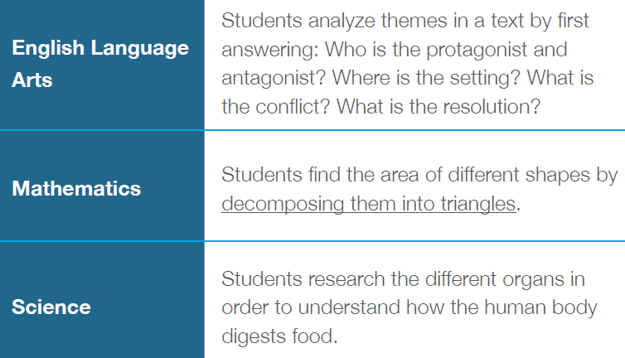
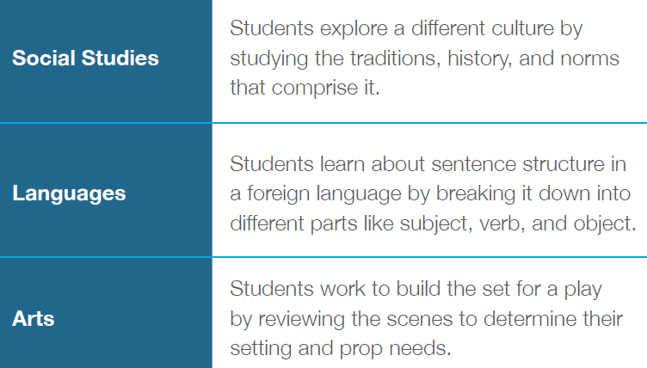

Slide 10
Pattern Recognition
Pattern recognition is all about recognizing patterns. Specifically, with computational thinking, pattern recognition occurs as people study the different decomposed problems.
Through analysis, students recognize patterns or connections among the different pieces of the larger problem. These patterns can be both shared similarities and shared differences.
This concept is essential to building understanding amid dense information and goes well beyond recognizing patterns amongst sequences of numbers, characters, or symbols.

Slide 11
Examples of Pattern Recognition in Everyday Life
Pattern recognition is the foundation of our knowledge. As infants, we used patterns to make sense of the world around us, to begin to respond verbally and grow our language skills, to develop behavioural responses, and to cultivate connections in this world.
Beyond this, pattern recognition also occurs when scientists try to identify the cause of a disease outbreak by looking for similarities in the different cases to determine the source of the outbreak.
Additionally, when Netflix recommends shows based on your interests, the technology (Artificial Intelligence and Machine Learning) relies on pattern recognition.

Slide 12
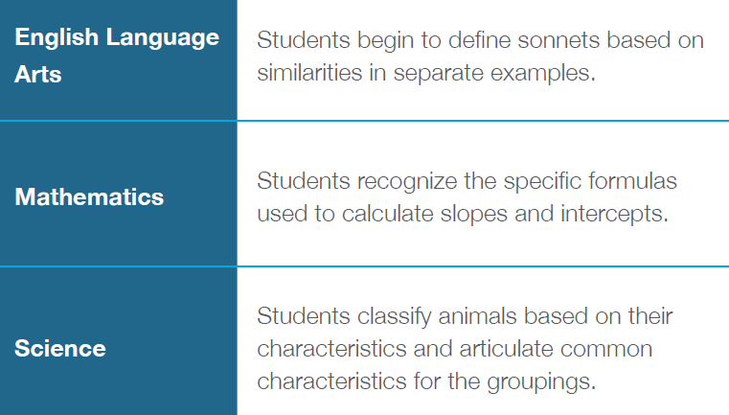
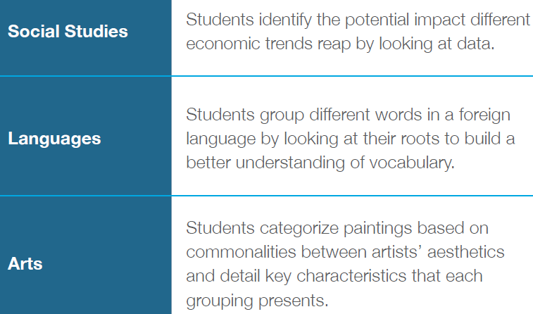
Examples of Pattern Recognition in Curriculum

Slide 13
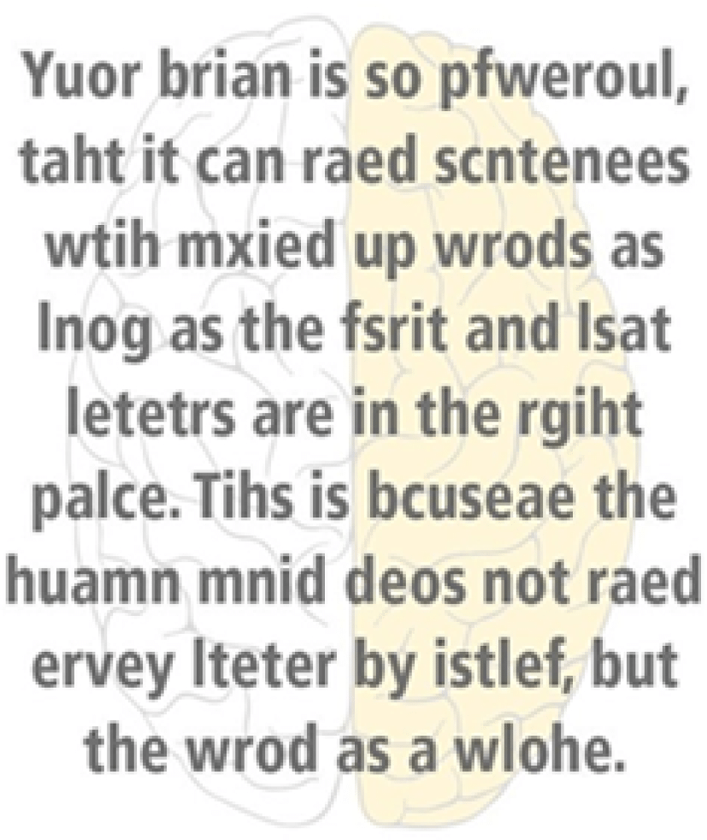

Slide 14
Abstraction
Abstraction enables us to navigate complexity and find relevance and clarity at scale.
Decomposition and pattern recognition broke down the complex, and abstraction figures out how to work with the different parts efficiently and accurately.
This process occurs through filtering out the extraneous and irrelevant in order to identify what’s most important and connect each decomposed problem.

Slide 15
Examples of Abstraction in Everyday Life
Educators use abstraction when looking at vast sets of student data to focus on the most relevant numbers and trends.

Slide 16
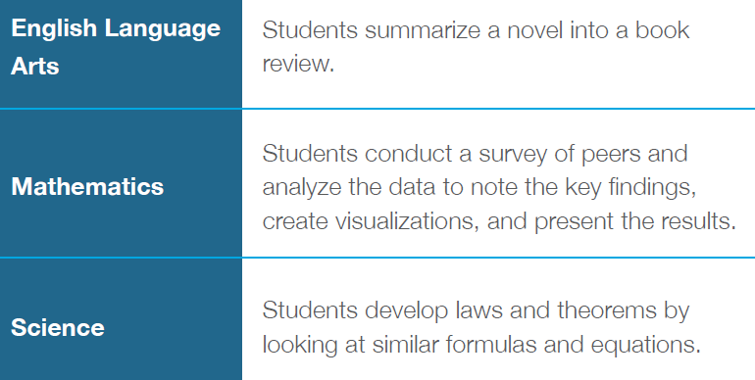
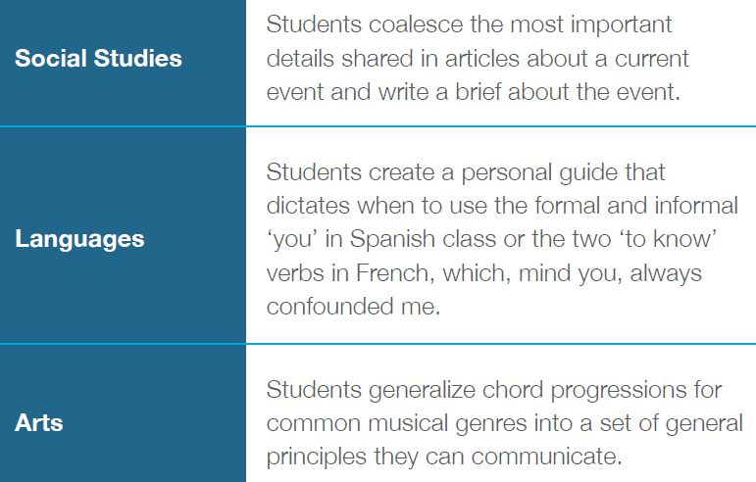

Slide 17
Algorithmic Thinking
An algorithm is a process or formula for calculating answers, sorting data, and automating tasks; and algorithmic thinking is the process for developing an algorithm.
With algorithmic thinking, we can construct a step-by-step process for solving a problem so that the work is replicable by humans or computers.
algorithmic thinking is not solving for a specific answer; instead, it solves how to build a sequential, complete, and replicable process that has an end point – an algorithm.
Designing an algorithm helps students to both communicate and interpret clear instructions for a predictable, reliable output.

Slide 18
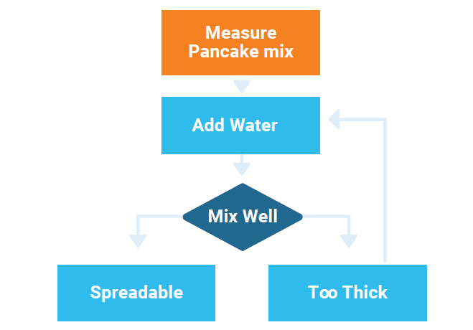
Examples of Algorithms in Everyday Life
If you’re an amateur chef, you follow recipes and directions for preparing food, and that’s an algorithm.

Slide 19
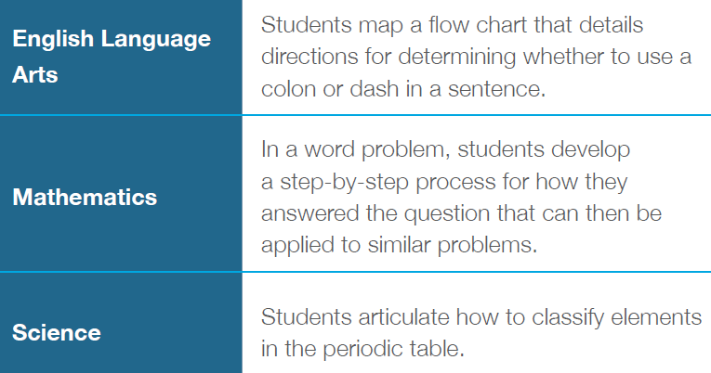
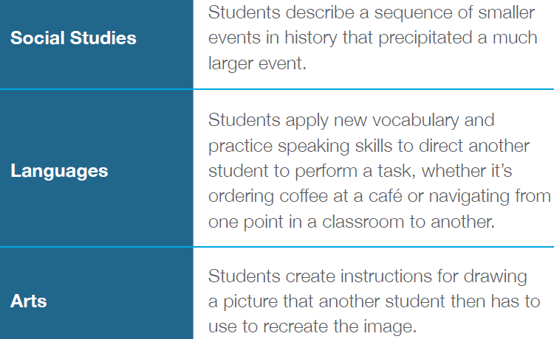

Slide 20
More Than Just Problem Solving
Computational thinking is a shift in how we approach problem solving.
With a formulaic process, we can navigate complexity and stay focused on what is important without losing site of the solution amongst all the noise.
With it, we can solve problems with mass amounts of data and lead unknown journeys through these data-filled landscapes.
This ability to navigate complex information and to think in a way that complements technological processes is essential to student readiness.

Slide 21
Study few real-time examples where you apply computation thinking methods
Examples for
Decomposition
Abstraction
Pattern Recognition
Algorithm

Slide 22
Given few examples – able to identify which one belongs to abstraction/decomposition/pattern recognition/algorithm Example: Mr Lim wants to buy a housing property in Singapore. How he can apply computational thinking to this task.
Study few real-time examples where you apply computation thinking methods – some scenarios
Given few examples – able to identify which one is the example of computational thinking approach

Slide 23
Closing Comments
• Decomposition’s aim is the “exploration” of possibilities.
Breaking down a big, complex issue into small manageable problems
Breaking down small problems into individual components
Not all components end up being useful.
• Pattern Recognition is interchangeable with “grouping”
Group components by similarities
Group questions and problems by category (categories can be freely created)
Not all groups end up being useful
• Abstraction can be thought of as focusing, prioritizing, or zooming in
Focus on the groups/components that will likely generate the best result
The parts we prioritized usually generate the most results per unit of resource
The components and groups in prior stages are ignored so as to conserve resources
• Algorithm’s aim is to:
Efficiently replicate when similar challenge is encountered in future (eg: 1 equation for any value of 𝑛)
Productively scale when similar challenge is pervasive (eg: 1 recipe/SOP that million users can follow)

Slide 24
Application of CT concepts to solve a 3D maze – Tutorial Activity
In this week’s activity, you will learn step-by-step procedures to apply Computational Thinking to solve a problem using 3D maze an education digital platform.
In this maze, the goal is to reach the shiny blue crystal. We need to write a visual code using the code blocks to command your hero to move to the crystal.
Within this challenge, a multitude of gems are scattered, presenting numerous possibilities for solving the puzzle. In fact, there are multiple pathways you can choose from, each involving a repeating pattern. Your task is to select a path that incorporates this pattern and implement it using the blocks available.
It proves highly advantageous to find a pattern that accomplishes a specific small task and then use that pattern within another loop to achieve a larger objective. In each challenge, begin by identifying a concise pattern of commands and create a pattern. Utilize this pattern to commence solving portions of the maze. As you encounter more intricate aspects of the maze, establish a new loop that reuses the code from your pattern. Ultimately, employ both the loops harmoniously to unravel the maze's solution.

